Slide 1


E-Asset
Management
Presented By:
Team
Dev_Octs
CodeFury Presentation 2023 Training Room 13

Slide 2
O v e r v i e w
Team Members
Project Scope
Application Features
UI Snapshots
Designing
Challenges
Learnings
Acknowledgement

Slide 3




1.Team Dev_Octs
Team Structure And Responsibilities
UI TEAM
Back-End Team
Rajnandini Singare Maturu Thrinadh Roohi Sood
Ishika Murarka Manas Singh
Anannya Agrawal Kanisha Jain
Souri Yaswanth Krishna

Slide 4
2.Project Scope
Problem Statement
The E-Asset Management system is a web - based application to keep track of several assets that can be borrowed, their availability, their current location, the current borrower and the asset history.
Assets include Laptops, Books, Mobiles and Devices.
The system should also be extensible.

Slide 5


3.Application Features
Layered Architecture
Checking Accounts (Borrower/Admin)
E-Asset Management
Validations
CRUD Operations
Exceptions
User Functions

Slide 6

Brief Description and details about Application Features
1.CRUD OPERATIONS
DAO LAYER
SAVE -
- int save(Asset asset)
- int save(Borrower borrower)
SHOW -
- Asset findByAssetId(String assetName)
- List<Asset> findAllAssets()
- Borrower findByBorrowerEmail(Borrower b)
List<Borrower> findAllBorrowers()
DELETE -
boolean deleteByAssetId(String assetName)
boolean deleteByBorrowerEmail(String email)
UPDATE -
Asset updateAccount(Asset asset);
Borrower updateBorrower(Borrower borrower)
2.CUSTOM EXCEPTION
Exception which will tell that the assets are not present - AssetNotFoundException
Exception which will tell that the borrower is not eligible to borrow assets - NotEligibleForAssetBorrowing
DAO EXCEPTION
Exception which will tell that the datastore is full and now no other element can be inserted - DataStoreFullException
Will tell that the particular record is no present in the datastore - RecordNotFoundException
Will be thrown when credentials entered are wrong
- InvalidCredentialsException For Repeatative data - DataAlreadyExistsException

Slide 7

SERVICE LAYER (Borrower) Business methods
3.USER FUNCTIONS
SERVICE LAYER (ASSET)
Business methods
method to search for the availability of asset -
boolean checksAssetAvailability(Asset asset,Borrower borrower)
method to check whether the borrower can actually borrow the asset or not -
public boolean canBorrow(Asset asset)
method will generate total fine -
public boolean returnAsset(Asset asset,Borrower borrower);
public boolean isLoginSuccess(Borrower b)
method used to calculate the total fine amount imposed to the borrower public double fineImposed(Asset
asset)

Slide 8




4.Checking Accounts (Borrower/Admin)
6.Layered Architecture
Checking all the accounts of Borrowers and admin
Model Controller
JdbcConnection Class Dao Interface DaoImpl Class
Service Interface ServiceImpl Class Exception Classes Enum Class
Util Class
5.Validations
Validation of frontend Credentials Validation of TEXT FIELDS

Slide 9

IMPORTANT NOTE -
User Accounts and Assets Checks - User and Asset checks will always be done on the basis of email(user) and asset(name) instead of user and asset ID because these ID’s are autogenerated in the application and so they will always be unique.And hence wont be helpful in identifying the duplicates accounts.
DEV_OCTS

Slide 10

4.UI Snapshots
1.Home Page

Slide 11
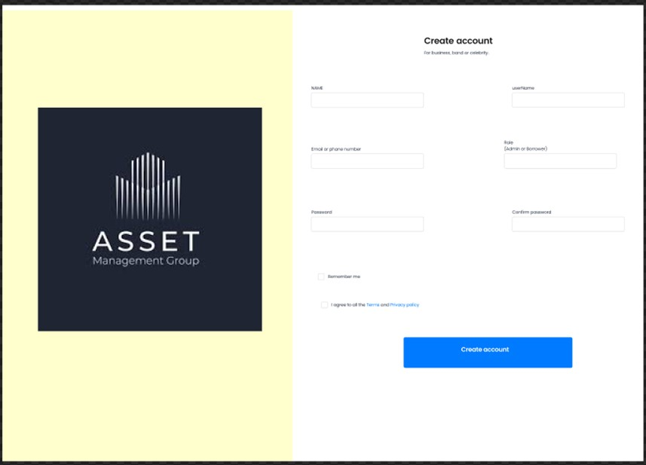
2.User Registration

Slide 12
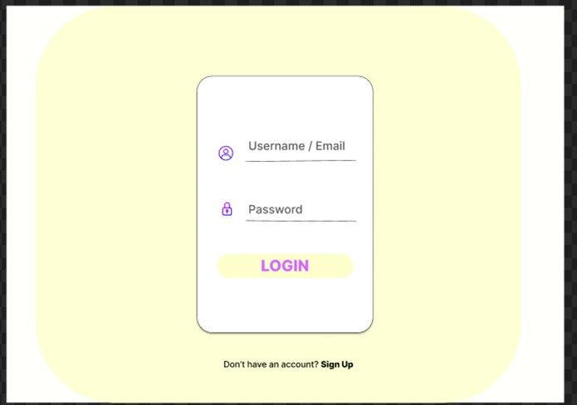

3.User Login

Slide 13
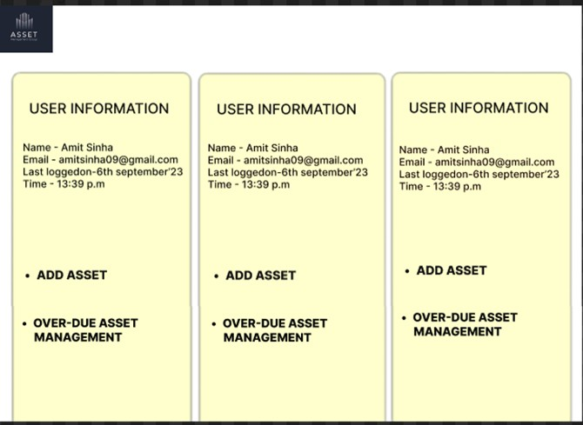

4.Home Page (Admin)

Slide 14
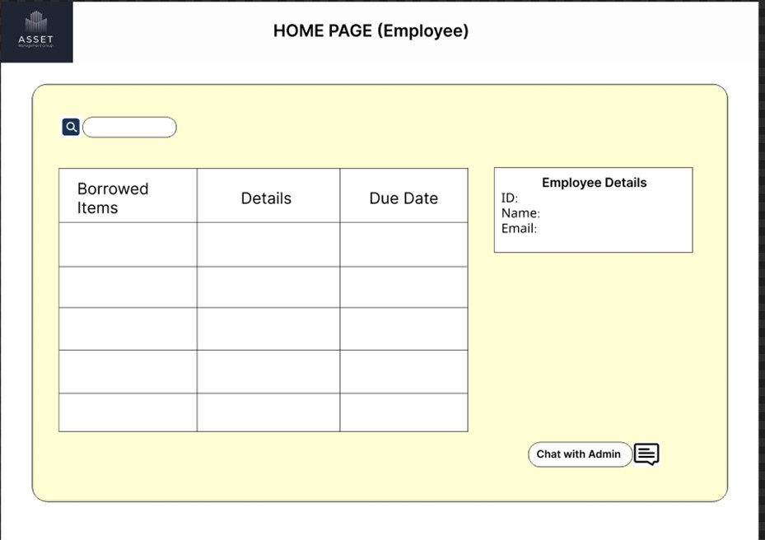

4.Home Page (Employee)

Slide 15
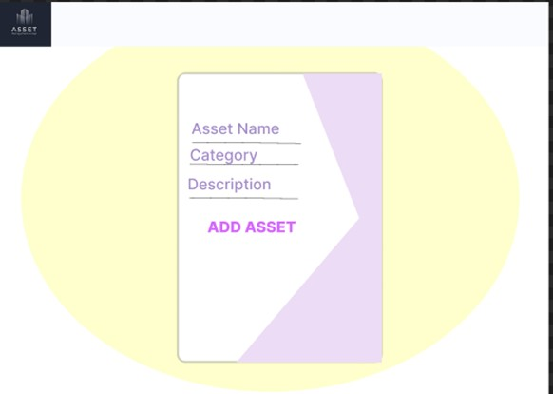

5. Add Asset

Slide 16
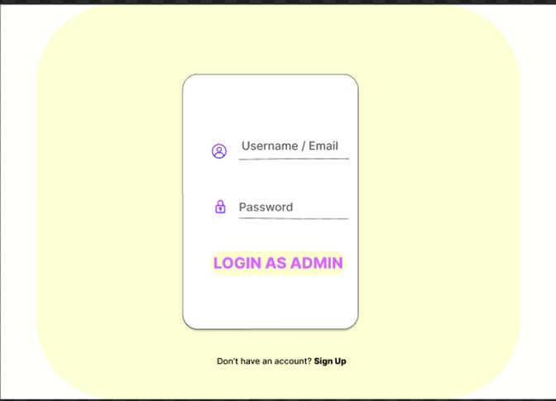
6. Admin Login

Slide 17

5.Designing
Attachments -
Data Flow Diagram - DFD
Class Diagram - UML
Entity Relationship Diagram - ERD
Use Case Diagram
RDBMS Table Structures

Slide 18


6.Challenges
ILLUSION OF AGREEMENT - Over
using visual representation of work such as diagrams and
AS A TEAM WHEN WE ALL STRIVED TO COMPLETE THE PROJECT, WE FACED SOME
CHALLENGES BUT ALSO
MANAGED TO OVERCOME THEM AND GOT SOME GREAT
EXPERIENCE
DIFFICULTY ESTIMATING TIME AND RESOURCES-
Enhancing features, bug fixing overcome using fragmenting the tasks into small chunks
models
TESTING AND DEBUGGING -
established a testing plan, understand the system you are working on
RIGID ARCHITECTURE
- overcome by iterative architecture which
allowed us for continuous improvement and adaptation

Slide 19
7.Learnings
Such type of Team Projects provides valuable opportunities to learn and grow in various aspects of tools, concept understanding, and collaboration with teamwork.
CONCEPTS UNDERSTANDING
TOOLS
COLLABORATION
Tool Proficiency Version Control IDEs and
Text Editors Testing,Debugging Tools
Documentation Tools
Technical Concepts Problem Solving Algorithm and Data Structures
Architecture and Design Patterns
Domain Knowledge
Communication Skills
Project Planning Peer Code Review Remote Collaboration Domain Knowledge

Slide 20
8.Acknowledgement
Dear LEADS,
We “DEV_OCTS” wanted to take a moment to express our heartfelt gratitude for the valuable learning experiences you've provided through the CODEFURY CONTEST (team projects) during our training.
These projects have been instrumental in enhancing not only our technical skills but also overall growth as a learner . They have allowed us to put into practice the theoretical knowledge we've gained during these training days, bridging the gap between theory and real-world application.
Your guidance, mentorship, and belief in our abilities have been pivotal in making these projects a success.
The experience of working collaboratively with our Collogues has been both challenging and rewarding, and I believe it will serve as a strong foundation for our future endeavors.
We really genuinely appreciate the effort and dedication you've put into making our learning journey meaningful and practical.
Warm regards, Team “DEV_OCTS”

Slide 21
THANKYOU
CODEFURY 2023
Presented By: DEV_OCTS

